Slide 1

Transitioning to Buprenorphine From Other Opioids
August 29, 2018
The State of the Art Conference
Hilton San Francisco Union Square
Howard Kornfeld, M.D.
Medical Director, Recovery Without Walls
Clinical Faculty, UCSF School of Medicine, Pain Fellowship Program
Distinguished Fellow, American Society of Addiction Medicine (ASAM)
Board Certified in Addiction Medicine, Pain Medicine, and Emergency Medicine
Notes:
A nice photo related to YOUR topic goes on the title page.

Slide 2
Conflict of Interest Disclosure
I, Howard Kornfeld, M.D. hereby declare that the content for this activity, including any presentation of therapeutic options, is well balanced, unbiased, and to the extent possible, evidence-based.
My partner/spouse and I have no financial relationships with commercial entities producing, marketing, re-selling, or distributing health care goods or services consumed by, or used on, patients relevant to the content I am planning, developing, presenting, or evaluating.
Notes:
This is important: Always include Need to Know (1-2 pages).

Slide 3
Educational Objectives
To understand the context of transitioning patients to buprenorphine from other opioids as addressing patient suffering in safe and effective ways
To understand the binding properties of buprenorphine which guide the structure and timing of buprenorphine introduction
To understand buprenorphine microdosing strategy that were published from Switzerland for addiction and from the U.S. for pain
To understand the issues within QTc interval prolongation and transdermal buprenorphine
To understand the “3 Day Rule” with respect to emerging opioid detoxification. CSAM and ASAM may wish to review application of this rule in light of the current opioid overdose epidemic
To understand perioperative consideration with respect to buprenorphine
Notes:
This is important: Always include Need to Know (1-2 pages).

Slide 4
Addressing Suffering: The Context for Transitioning To Buprenorphine
Kornfeld, Howard. "Buprenorphine as a Safety Net for Opioid Treatment of Nonmalignant Pain." Letter to the Editor. Arch Intern Med, vol. 17, no. 6, 28 Mar. 2011.
Comerci, Jr., George, et al. "Controlling the Swing of the Opioid Pendulum." New England Journal of Medicine, no. 378, 22 Feb. 2018, pp. 691-93.
Dasgupta, Nabarun, et al. "Opioid Crisis: No Easy Fix to Its Social and Economic Determinants." AJPH PERSPECTIVES, vol. 108, no. 2, Feb. 2018, pp. 182-86.
Notes:
This is important: Always include Need to Know (1-2 pages).

Slide 5

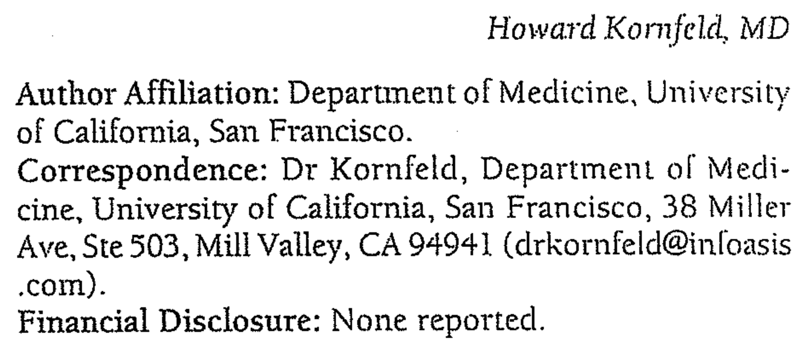
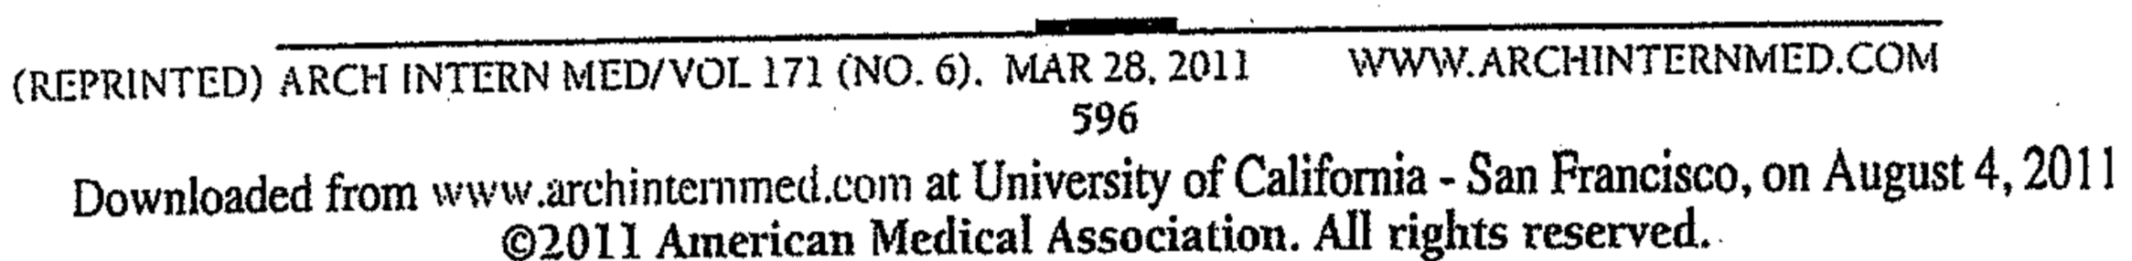

Slide 6

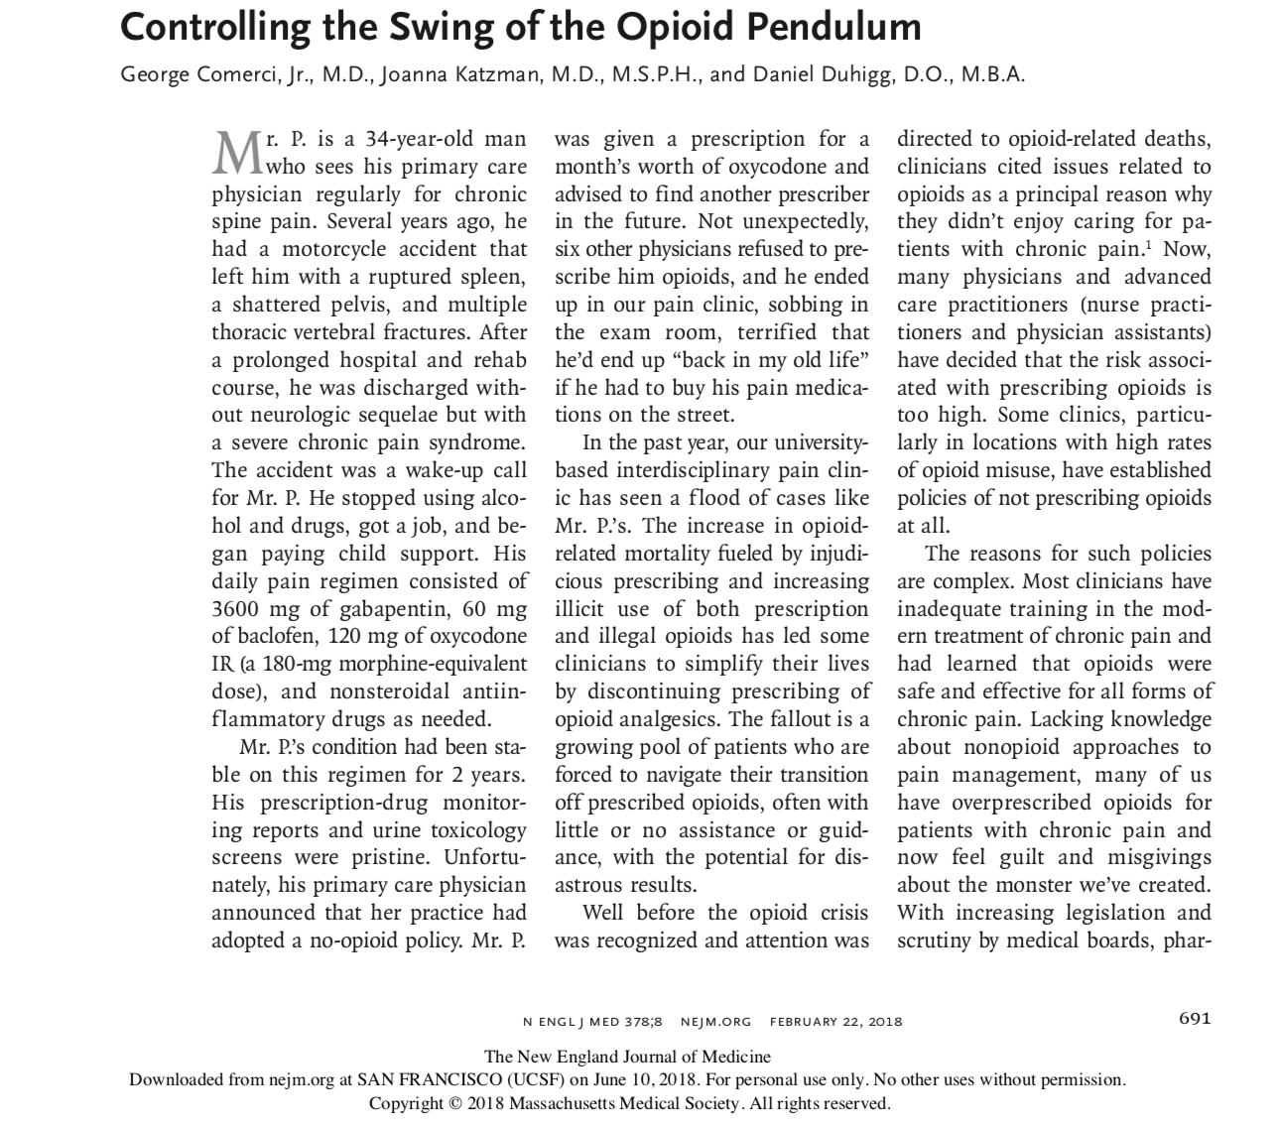
Notes:
This is important: Always include Need to Know (1-2 pages).

Slide 7

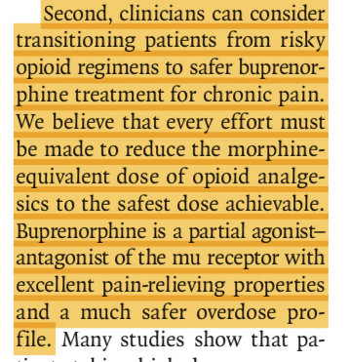
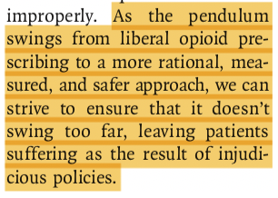
Notes:
This is important: Always include Need to Know (1-2 pages).

Slide 8
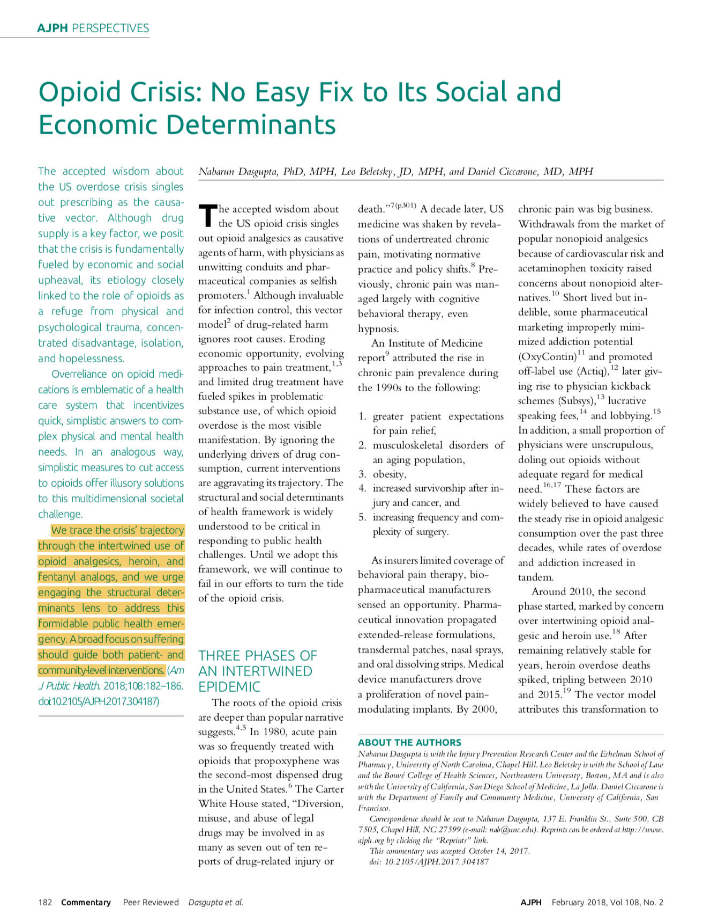

Slide 9
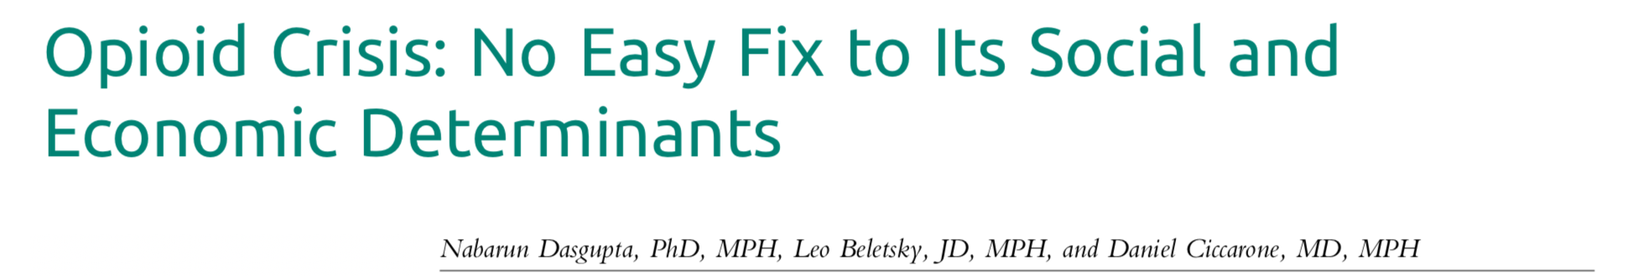




Slide 10
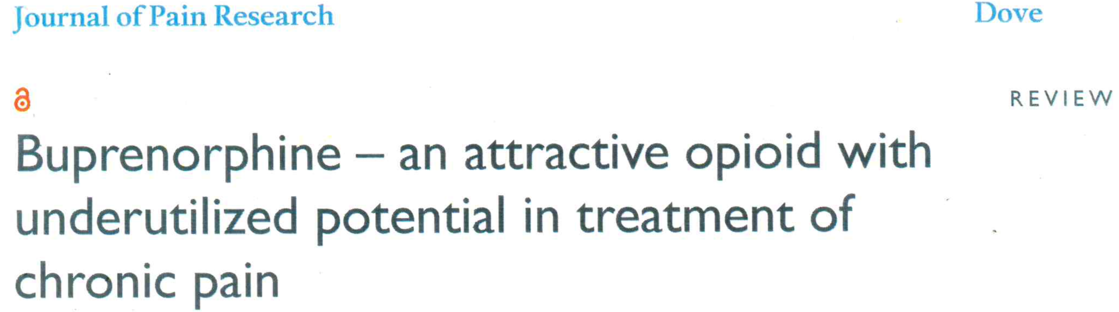

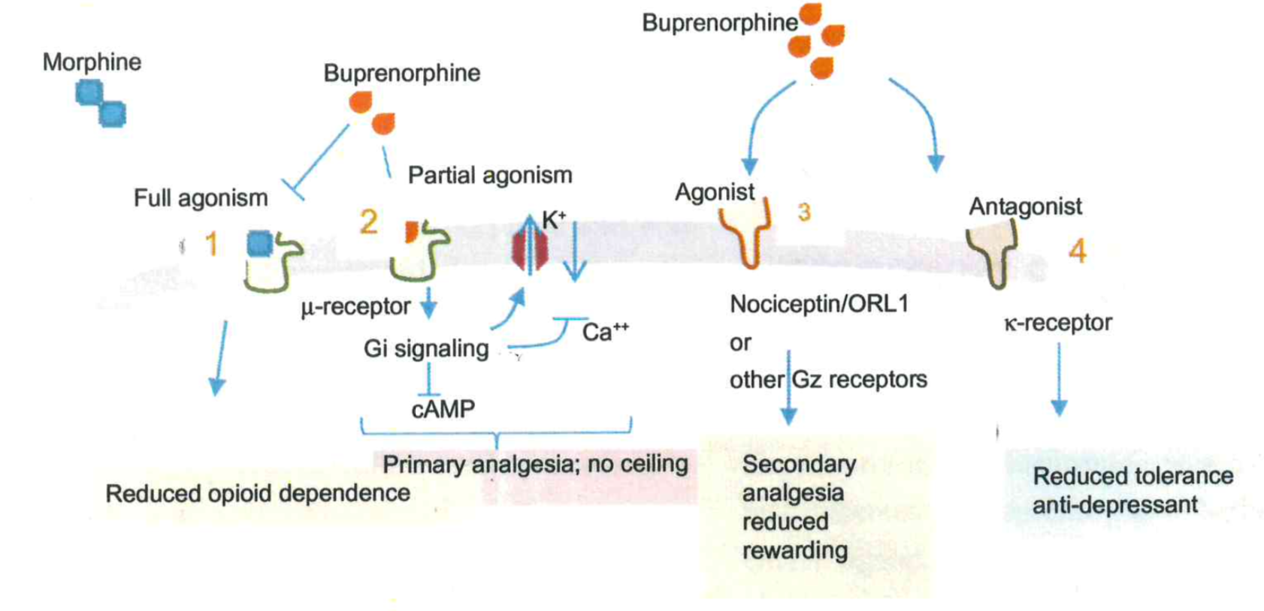

Slide 11
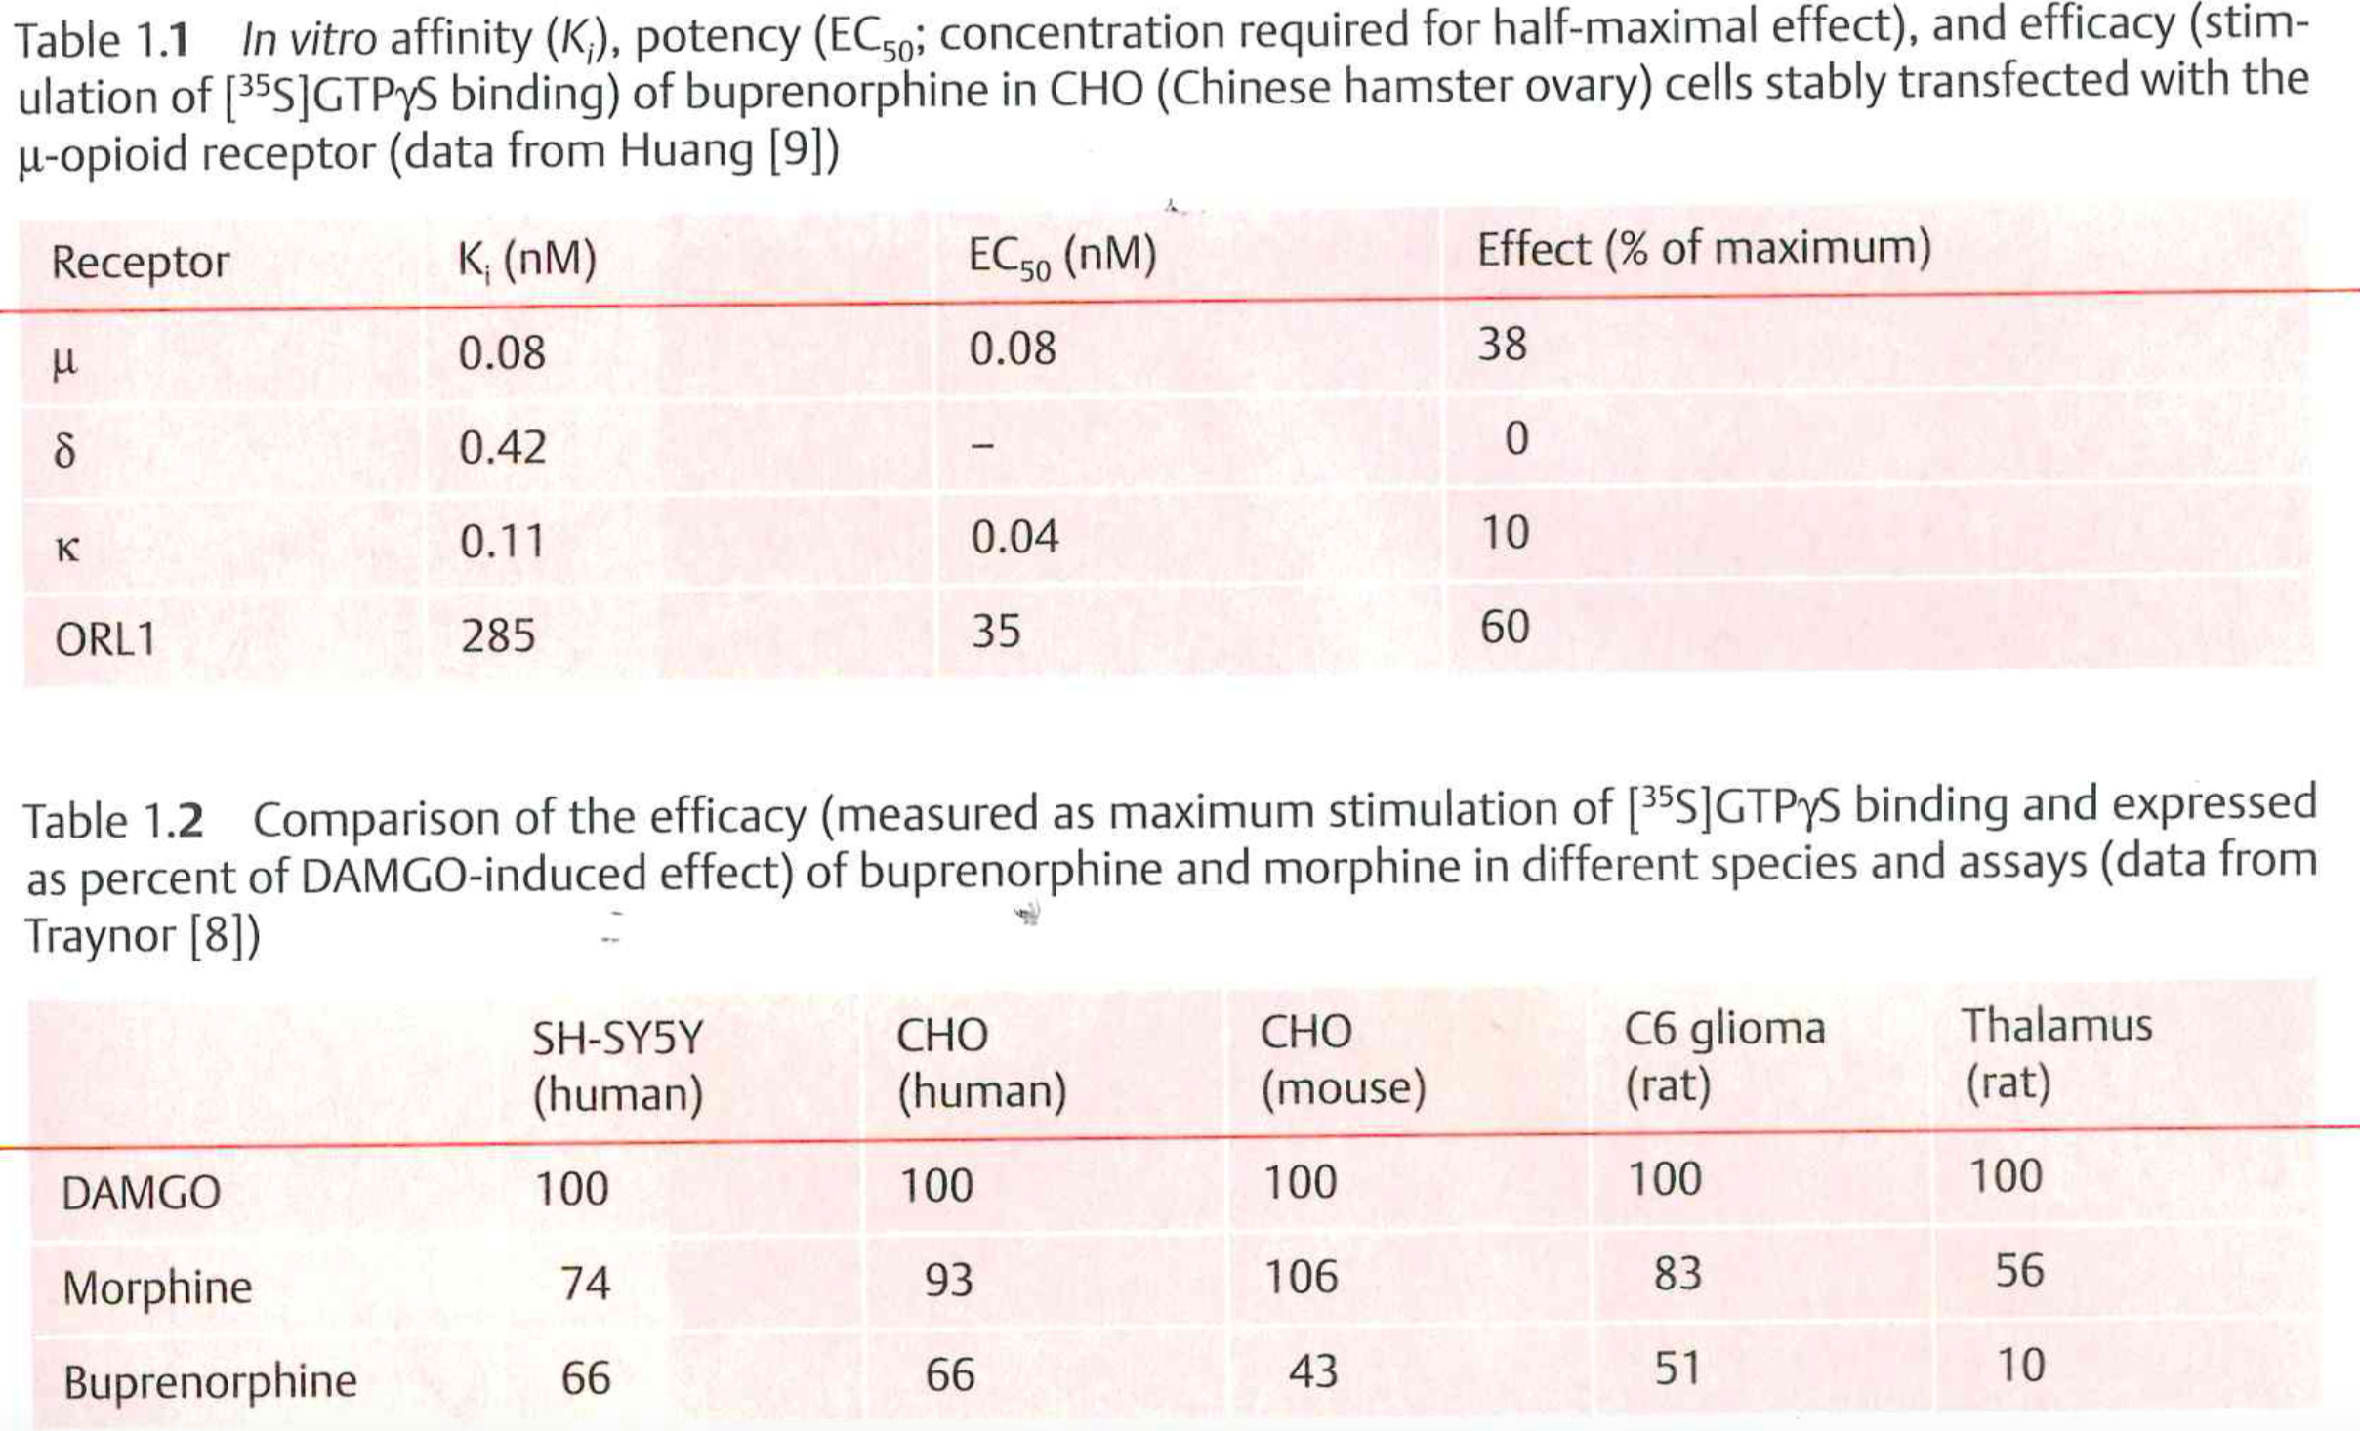

Slide 12
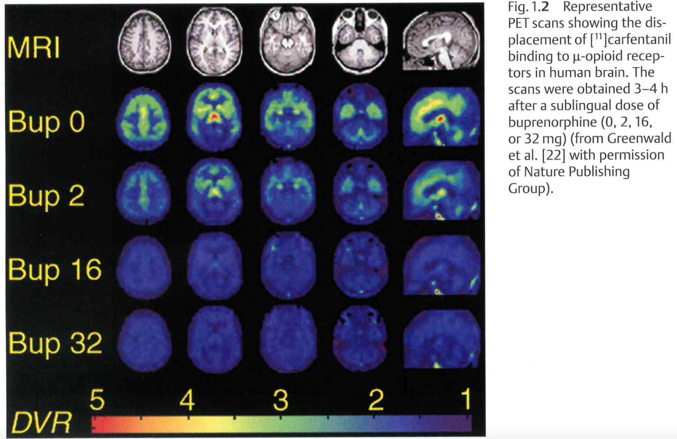

Slide 13
evolution of buprenorphine induction through microdosing
Legal Aspects- DATA 2000
  In U.S., restricted to pain
Swiss methods: Bernese and “Zurichese”
Kornfeld and Reetz – Buprenorphine for Pain
CHCF – Buprenorphine: Everything you need to know

Slide 14
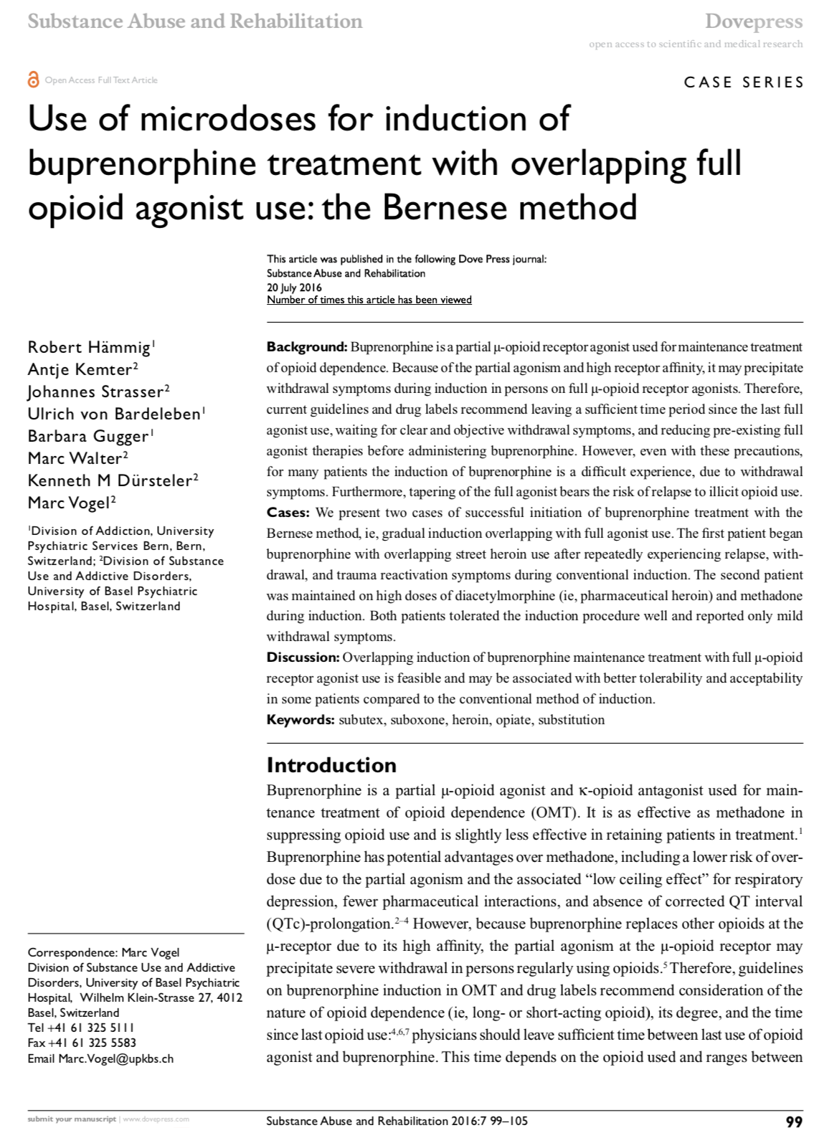

Slide 15
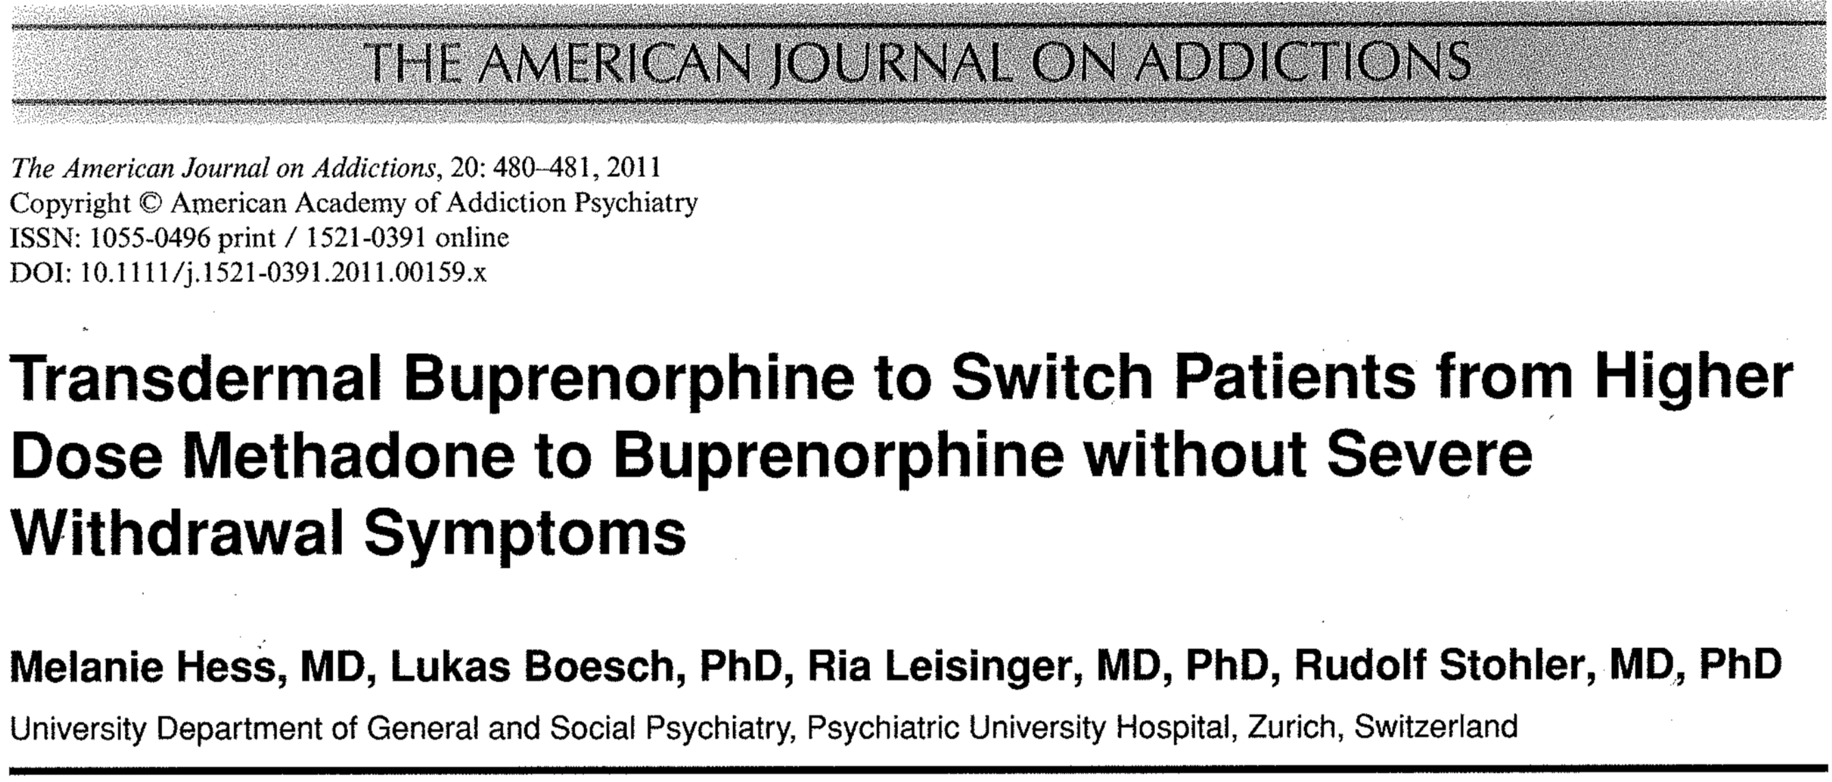

Slide 16
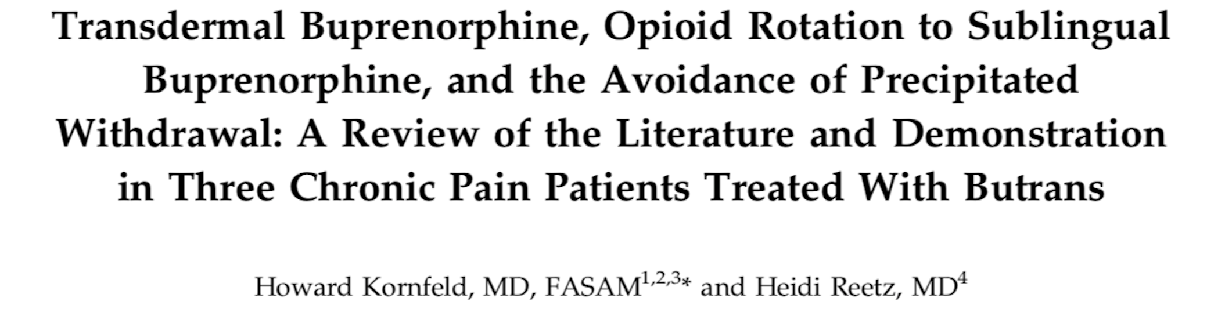

Slide 17



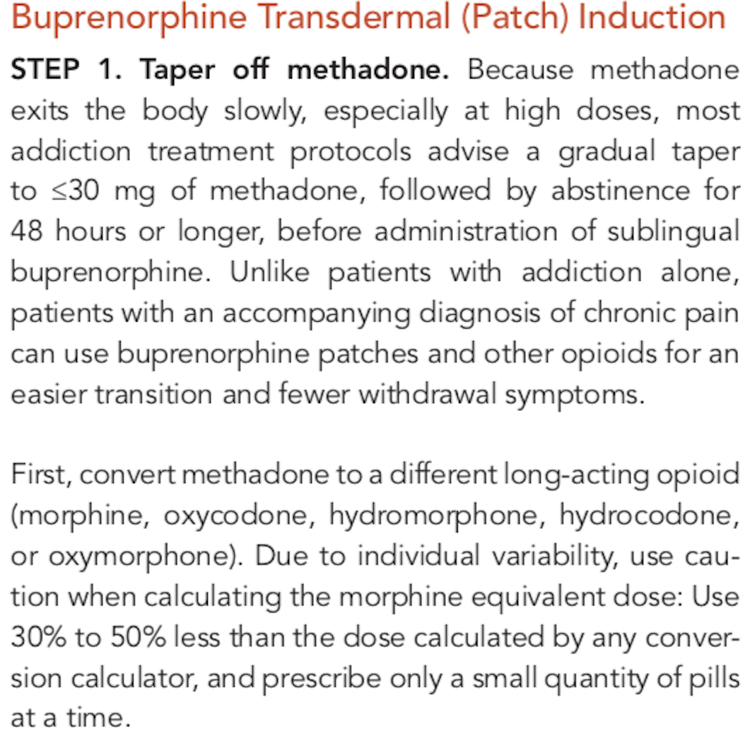
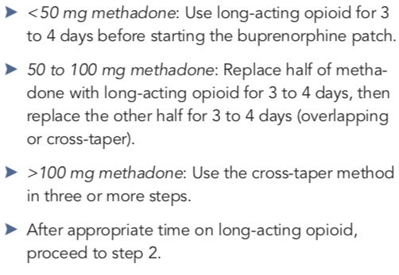

Slide 18
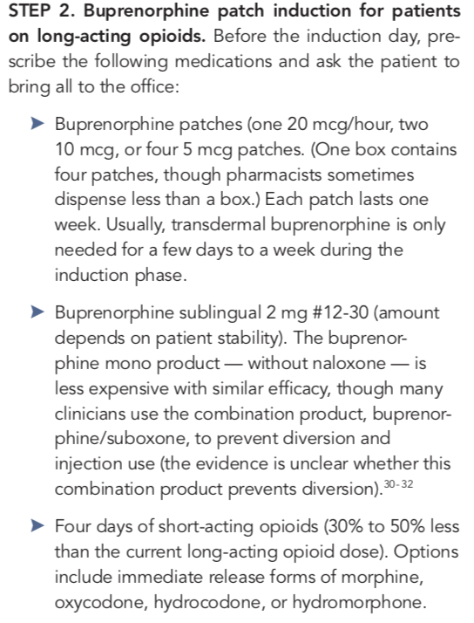
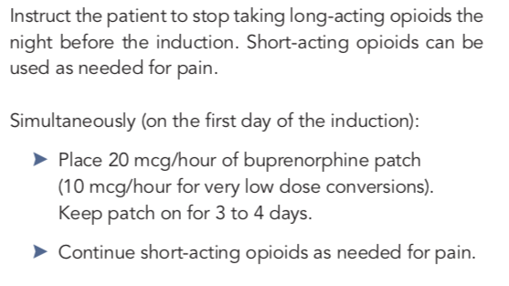

Slide 19
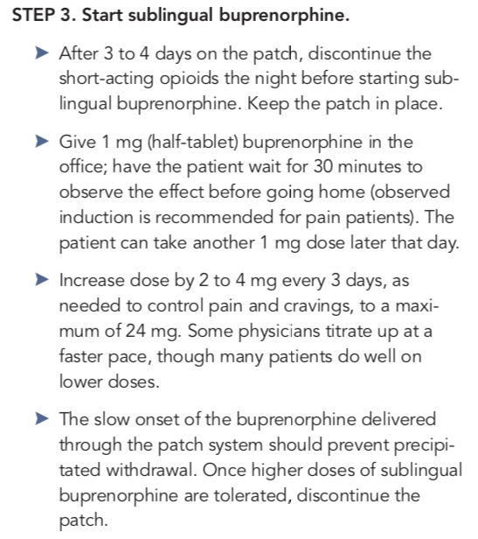

Slide 20
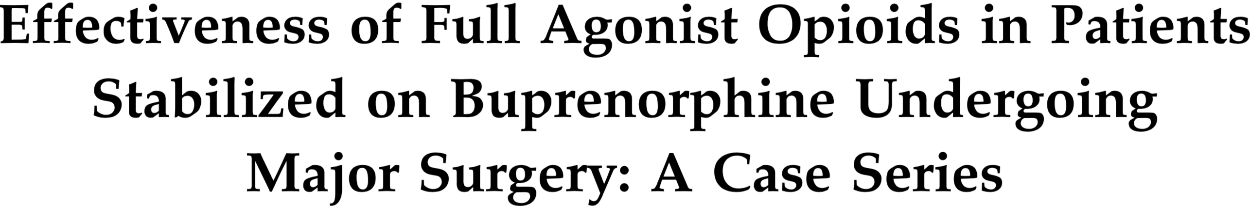

Slide 21

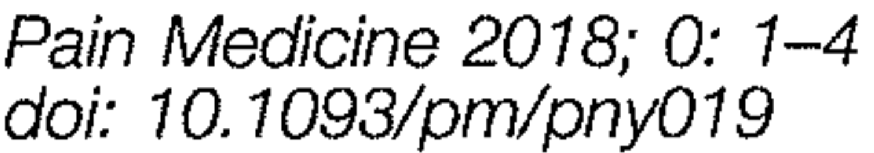
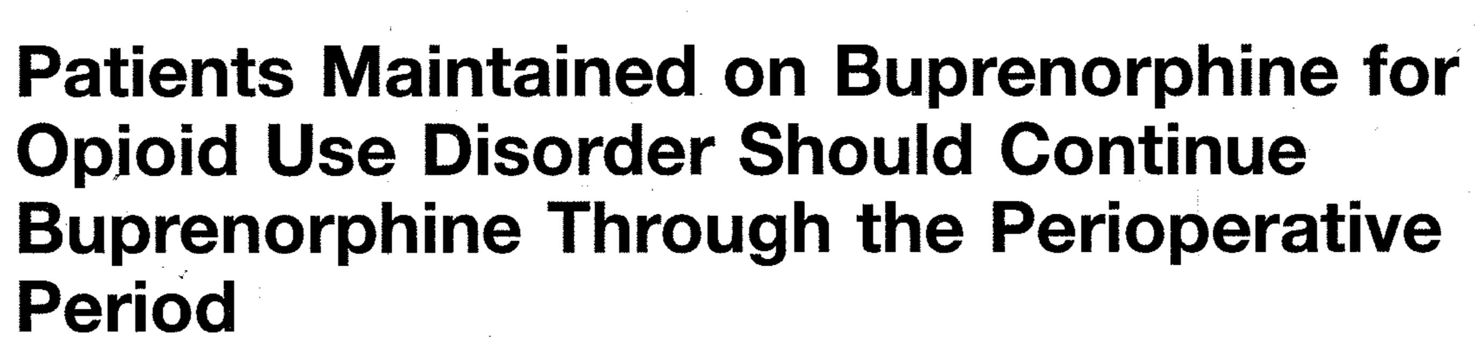
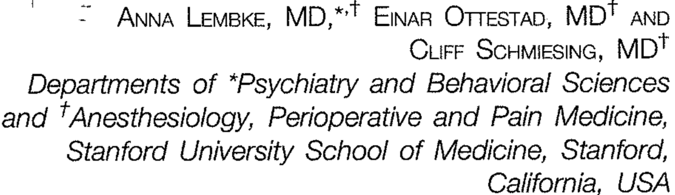


Slide 22
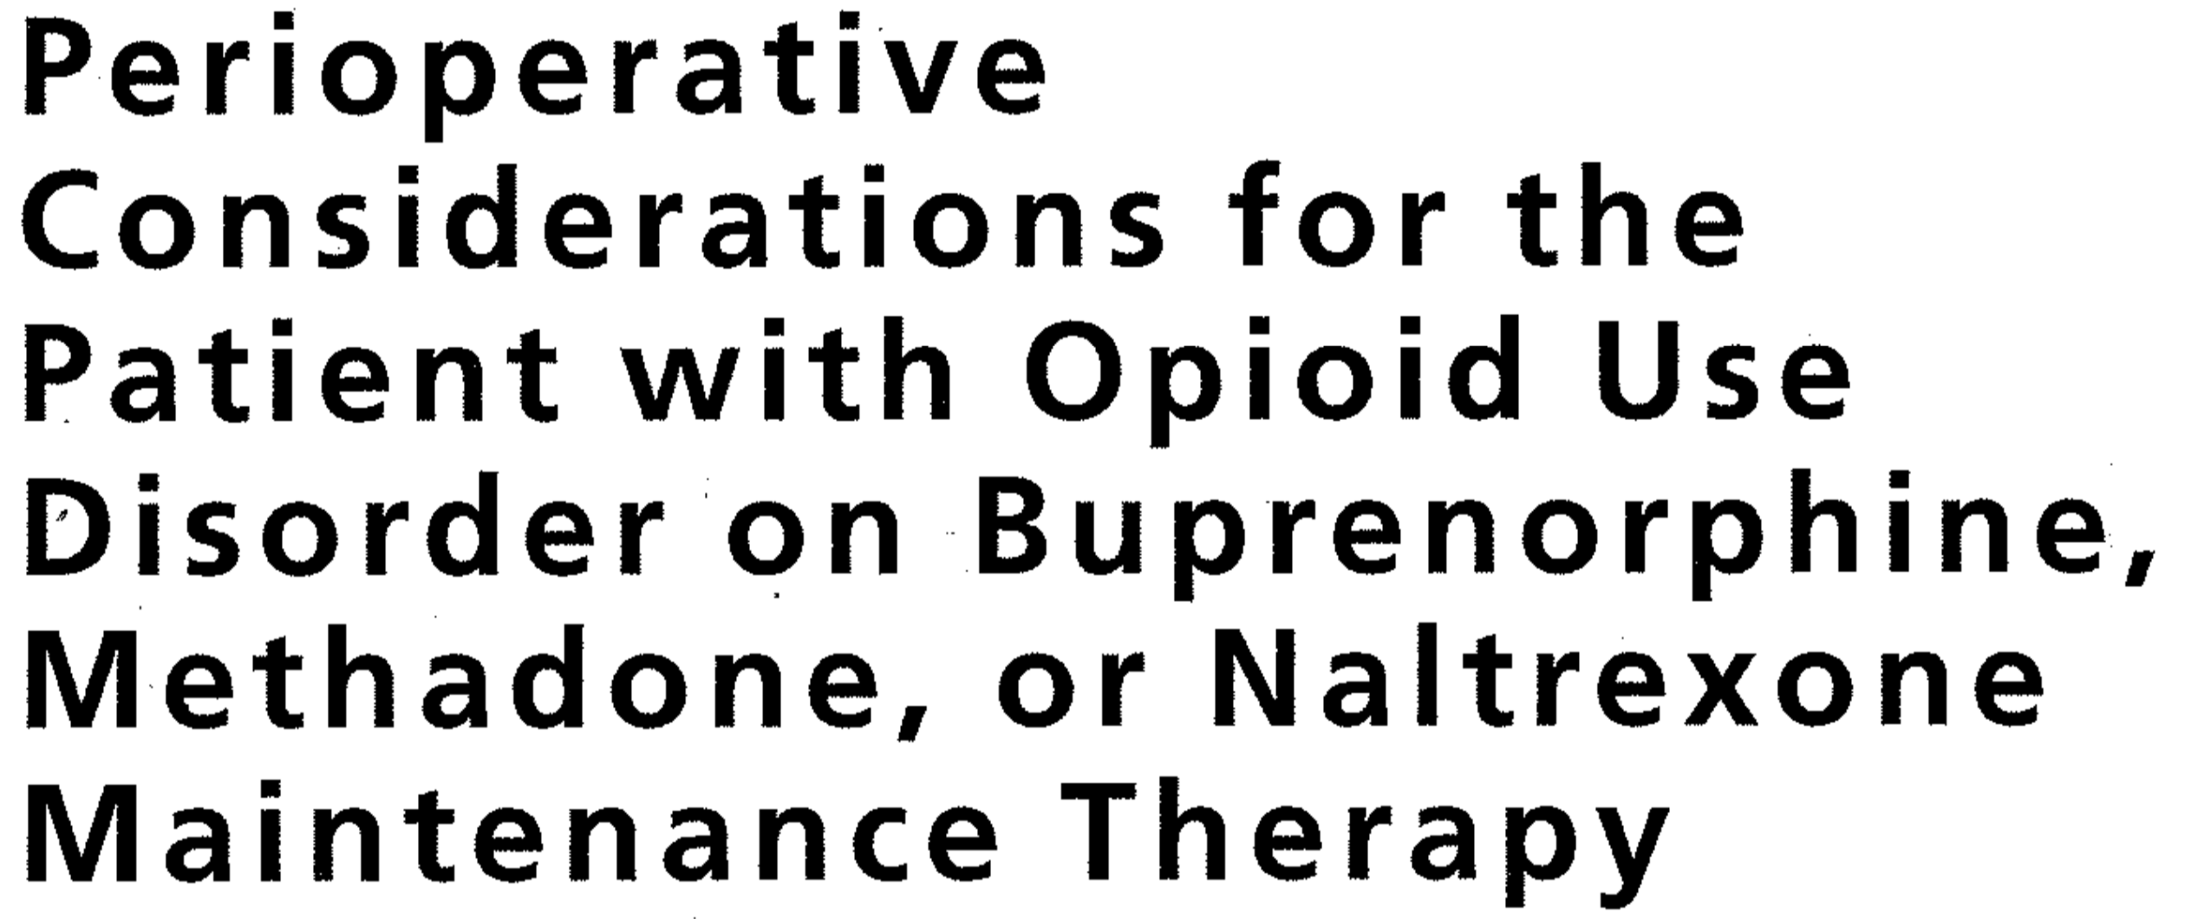
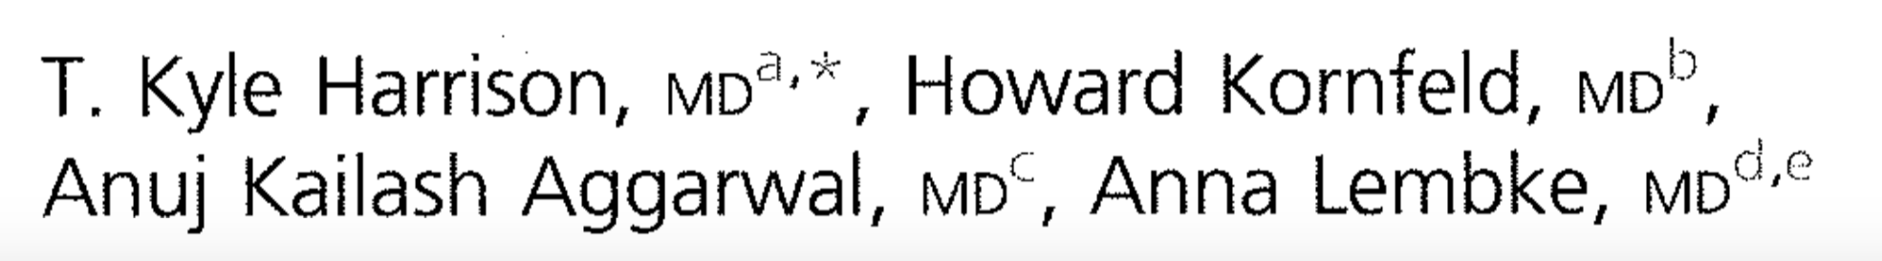
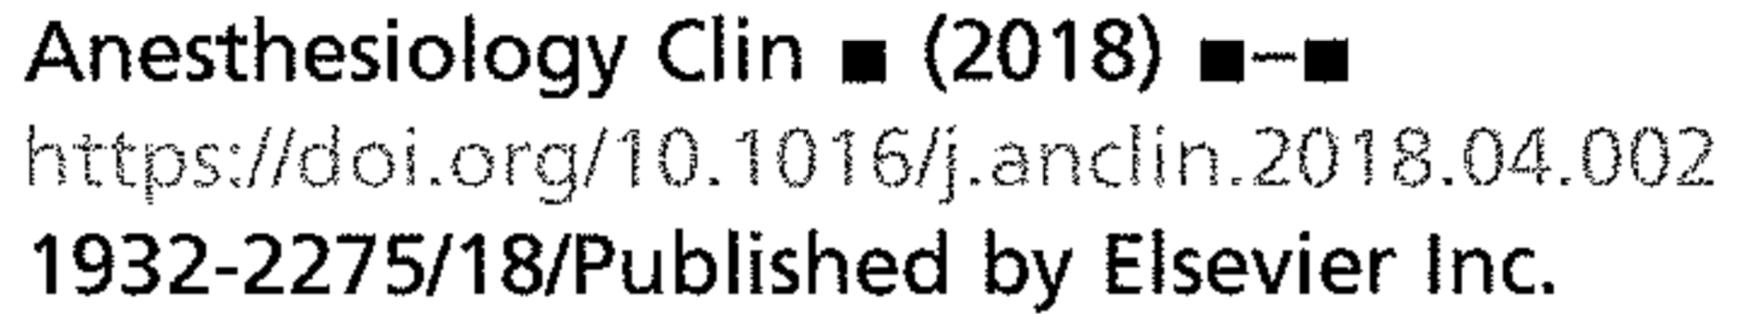

Slide 23
